Slide 1

Demosacing
Color reconstruction

Slide 2
Topics to be discussed
Motive
What is demosacing
Why we need demosacing
Project Roadmap
Tasks Accomplished

Slide 3
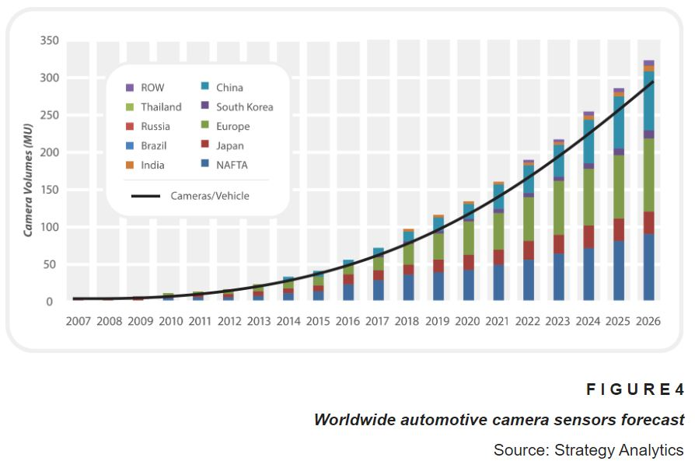
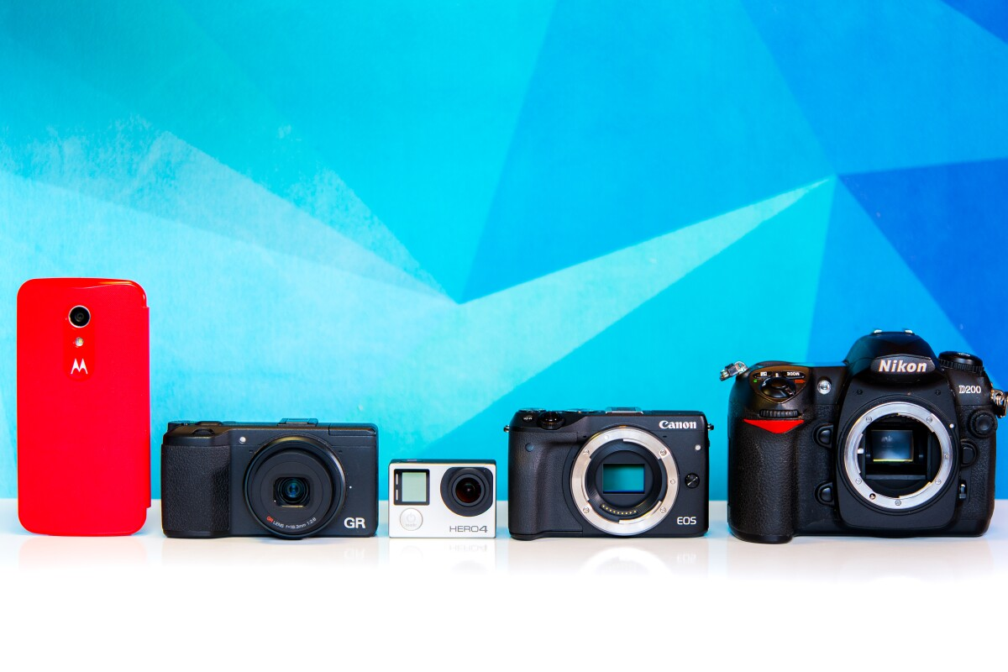

Slide 4
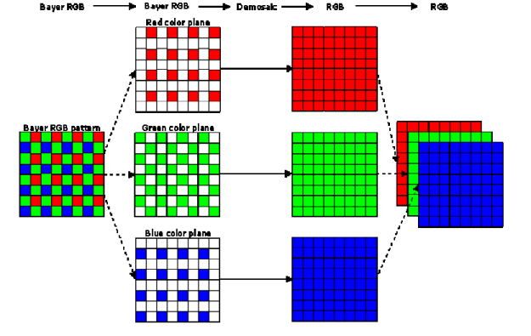
Demosacing
Bayer Filter
Getting full channel information at every pixel
Using Interpolation to gather information from surrounding pixel

Slide 5
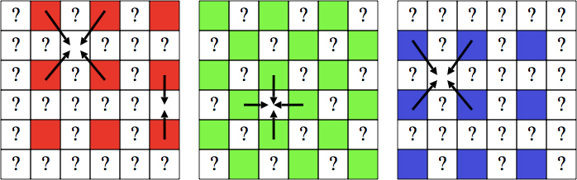
CORRELATE

Slide 6
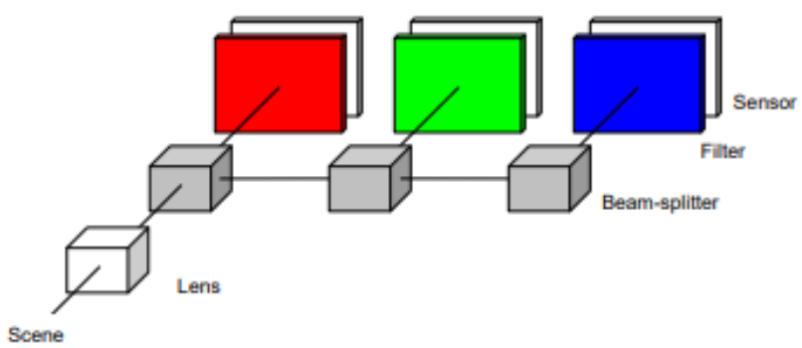
Beam Splitter
Using Beam Splitter
3 filters (Red, Green, Blue)
3 camera sensors
Optimal results
Optically hard to assemble
Highly expensive and unpractical for most scenarios

Slide 7
Roadmap
Selection of Appropriate Dataset
Developing a program to make raw images
Demosacing
Performance Evaluation

Slide 8
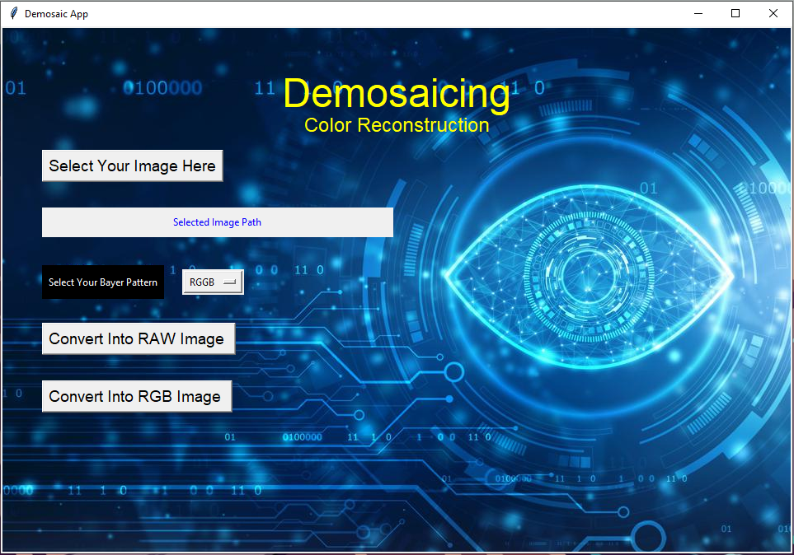
Interface
To select any image from windows explorer
Display the path of selected image
Select the Bayer pattern of the Image
Convert an image to raw form
Convert an image from raw to full channel by applying demosacing

Slide 9
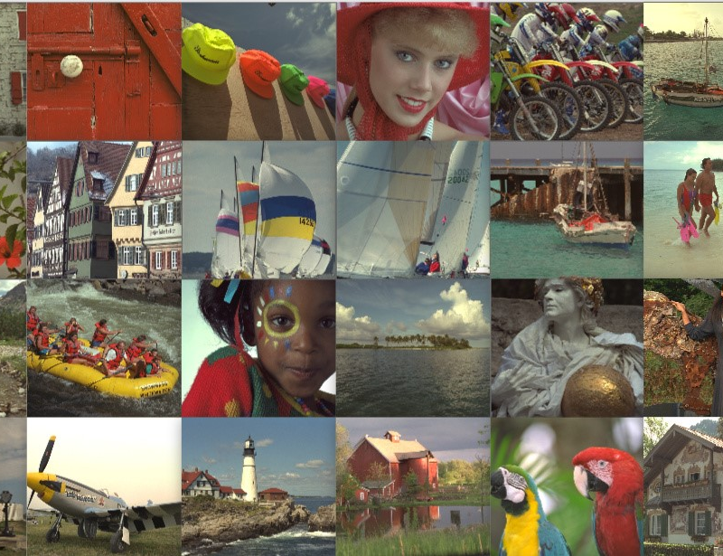
Dataset
Captured using kodak film camera
Contains full channel information
Best for performance evaluation

Slide 10
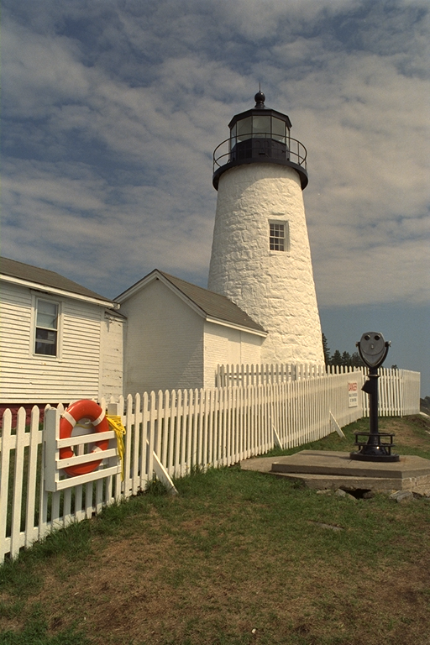
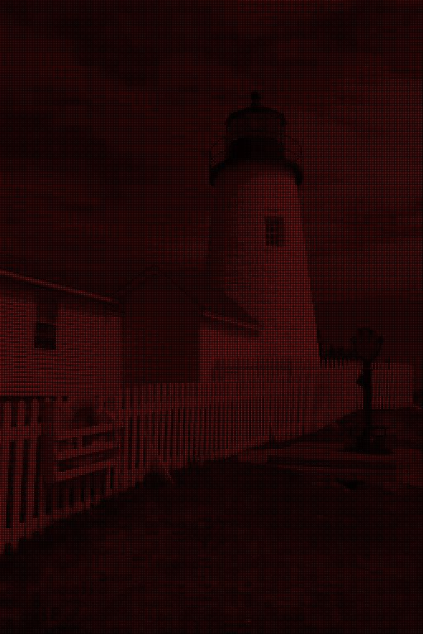
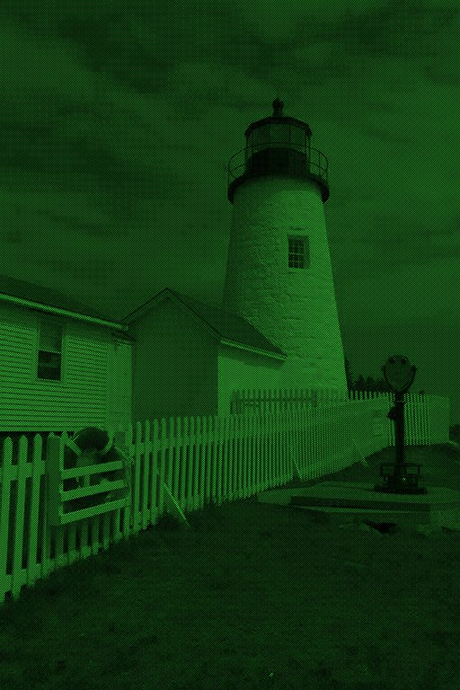
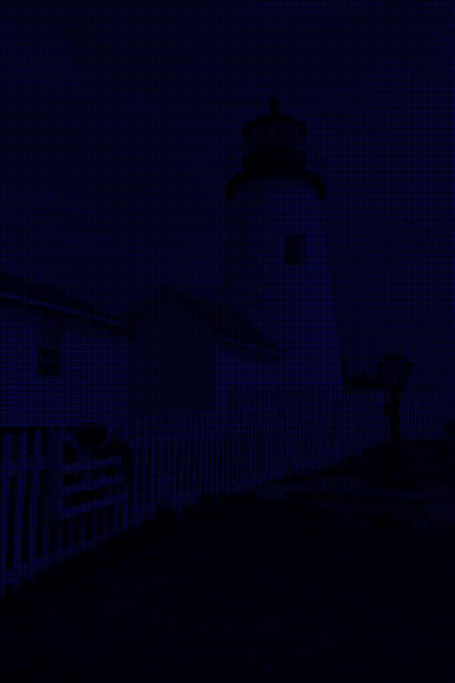
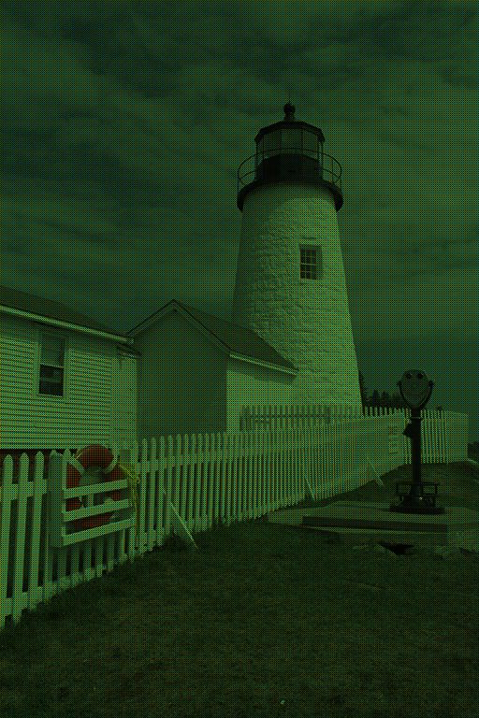
RAW Conversion
RGB
red
green
blue
raw

Slide 11
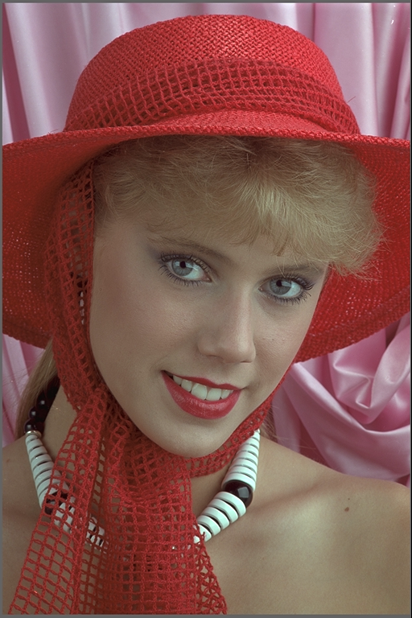
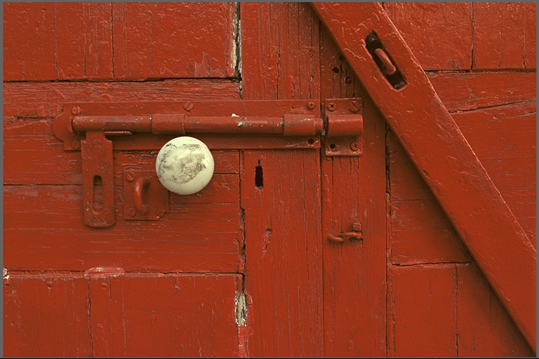
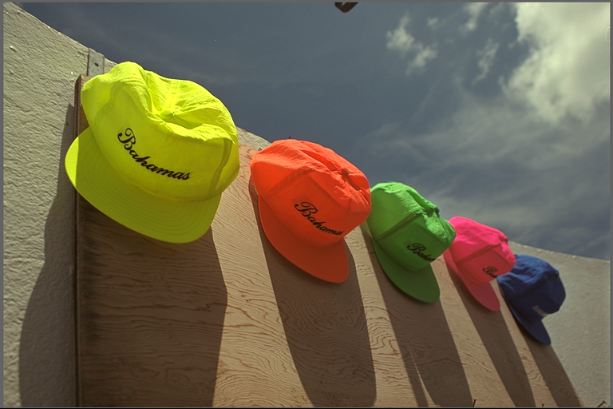
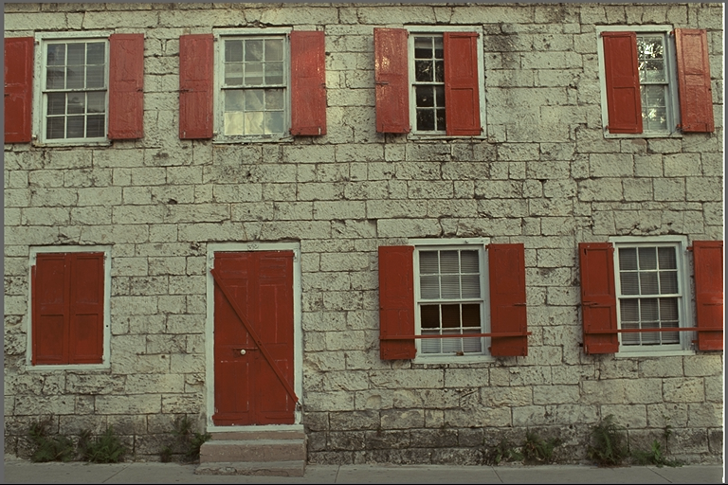

Slide 12
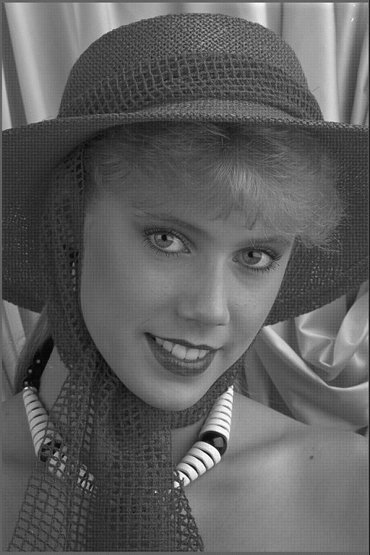
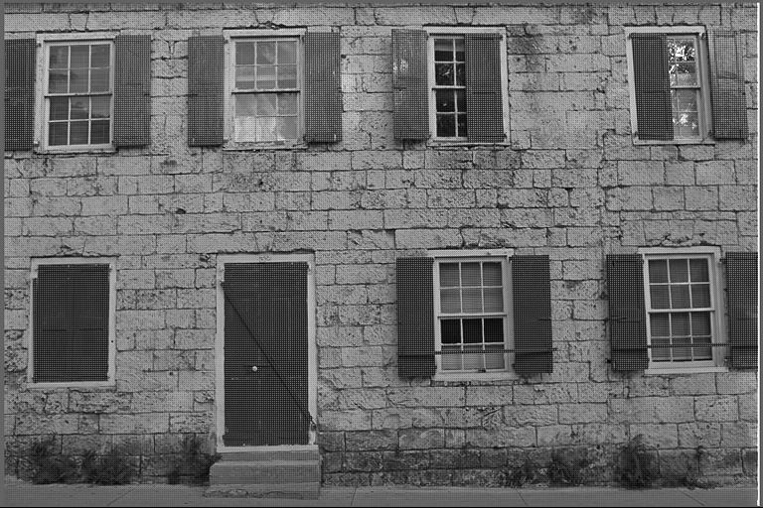
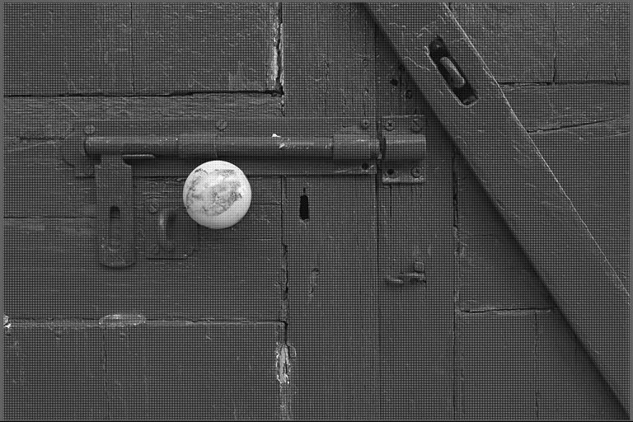
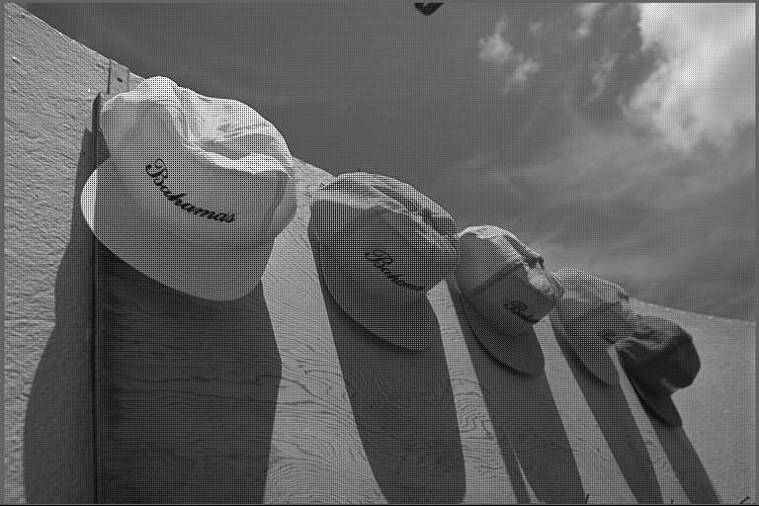
Single Channel
Contains only one value at a pixel either red, green or blue
Returns an image with a Bayer pattern

Slide 13
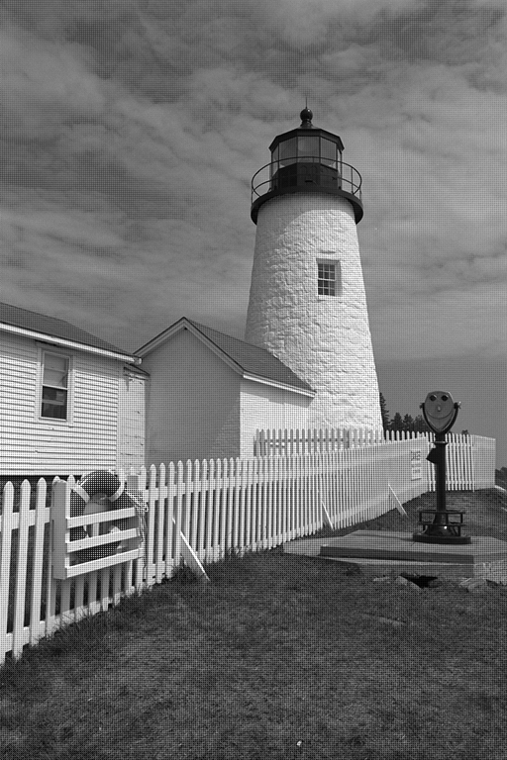
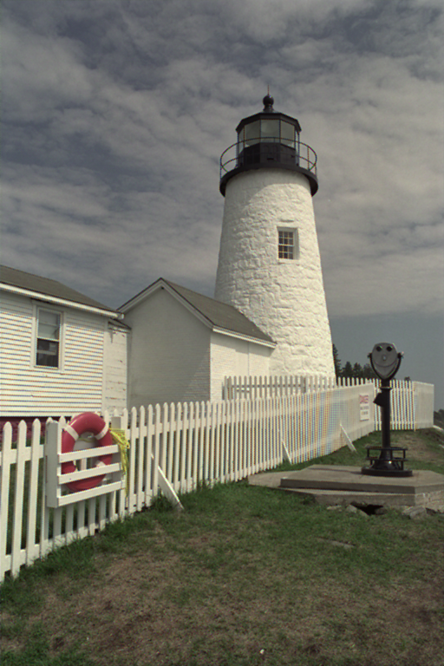
Original Image
RAW image
After Demosacing

Slide 14
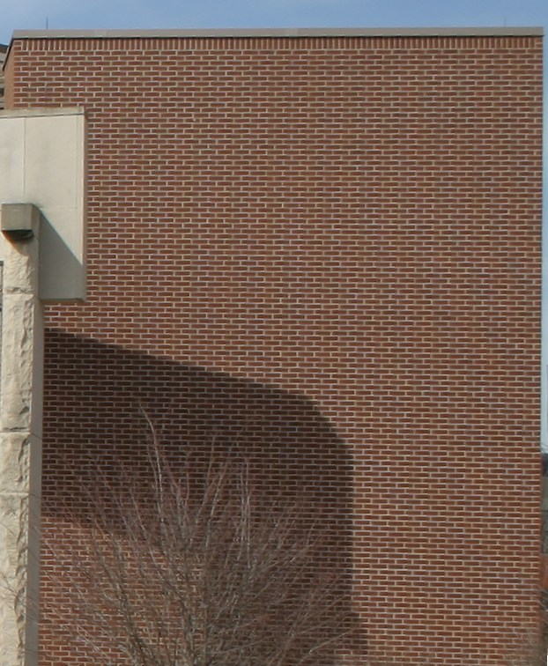
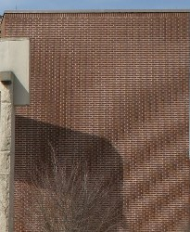
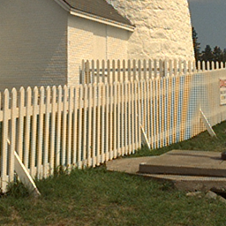
Problems
Following are three major problems of Demosacing Algorithms:
Zipper Artifacts
Chromatic Aliases
Chromatic Aliases
Zipper Artifacts

Slide 15
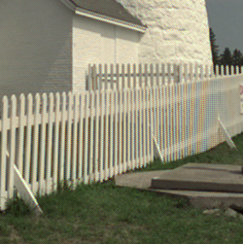
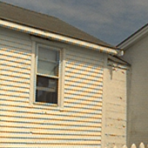
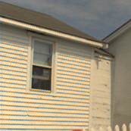
Performance Evaluation
MATLAB
MATLAB

Slide 16
Thank You

